Slide 1


Slide 2

MICROSOFT WORD

Slide 3
WHAT IS A MICROSOFT WORD
Microsoft word is document use to Write any data in any font, size, colour.
It is used for Question papers, letters,Information etc
You will learn more about this in upcoming slides.

Slide 4
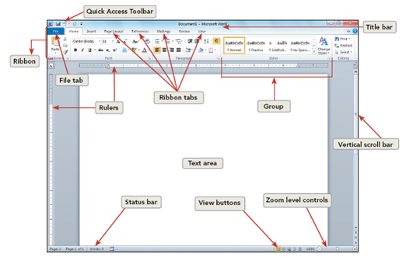

Slide 5
01
Creating word file

Slide 6
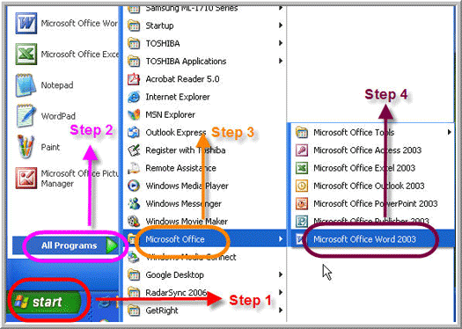
Steps for Creating Word file:
Go to start
All Programs
Microsoft office
Microsoft word

Slide 7

Steps to Change size of text : Type text
Go to home
Dropdown value of number
Change the size

Slide 8
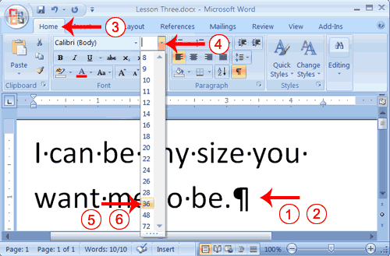


Slide 9

Steps to Change font of text : Type text
Go to home
Dropdown value of font name
Change the Font

Slide 10
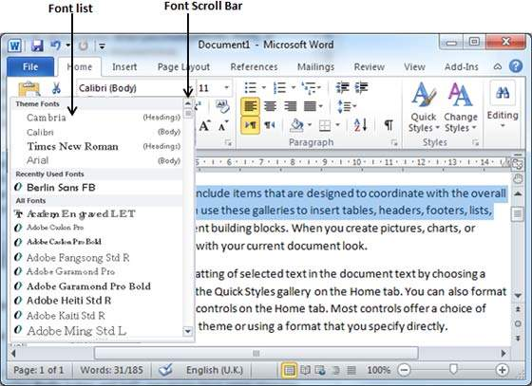


Slide 11
Steps to Insert Pictures : Go to Insert
Picture
Click on picture folder
Click on Image
Insert

Slide 12
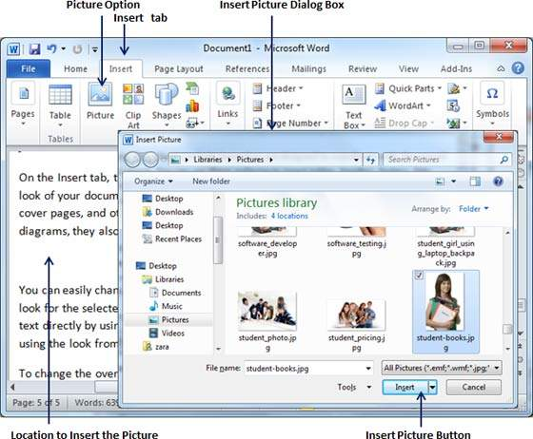

Slide 13

Steps to Insert Shapes: Go to Insert
Shapes
Click on any shape
Drag on screen the shape
Shape inserted

Slide 14
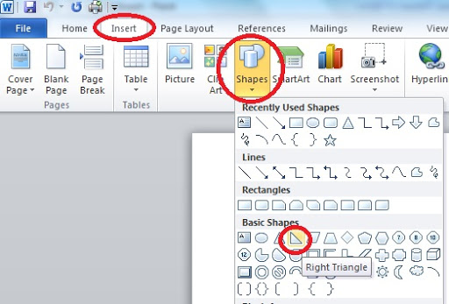

Slide 15

Steps to Save document: Go to File
Ctrl + s = Save document
Save as
Save the name
Select folder to save
Save

Slide 16
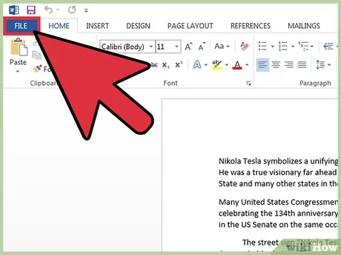
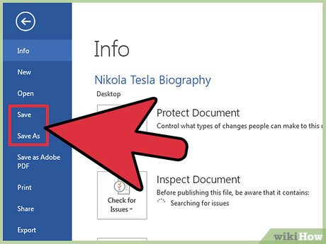

Slide 17
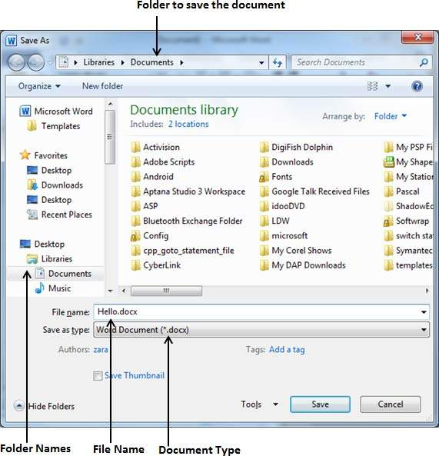


Slide 18
Thank-you

